Slide 1
HPC TNT - 1
Tips and tricks for code optimisation and parallellization
code less, compute more
CalcUA Core Facility
Annie Cuyt ☐ Stefan Becuwe ☐ Franky Backeljauw ☐ Geert Borstlap ☐ Engelbert Tijskens

Slide 2
VSC – Flemish Supercomputer Center
vscentrum.be
Flemish Supercomputing Center
hosted by “Hercules Stichting”, Brussels
Ministry of Science and Innovation
Responsible for Supercomputing Infrastructure in Flanders
Academic research
Flemish Technological Institutes
Industrial R&D
Sensibilization, training, user-support, collaboration, …

Slide 3


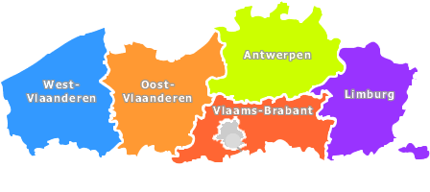



VSC - partners

Slide 4


VSC – infrastructure
Tier-0
European
Tier-0
European
PRACE
Tier-1
national
regional
Tier-1
national
regional
VSC network
Disk storage
Job management
Tier-1
UGent
Tier-2
(regional)
university
Tier-2
(regional)
university
Tier-2
UAntwerp, VUB, UGent
KULeuven + UHasselt
BE
grid
EGI
Tier-3
desktop
Tier-3
desktop

Slide 5
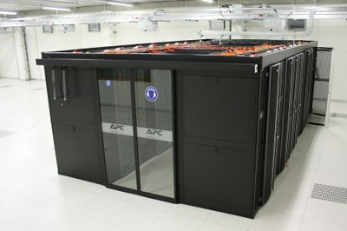


VSC – Tier 1
528 computing nodes
64 GB RAM/node
8448 cores @ 2.6 GHz
Intel Sandy Bridge
450 TB storage
Infiniband
176 Teraflops
June 2012: 118
November 2012: 163
June 2013: 239
November 2013: 306

Slide 6

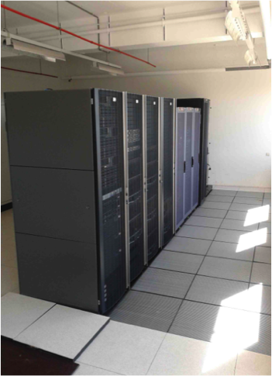

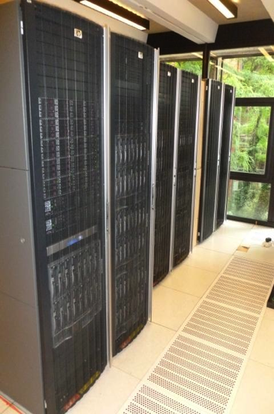
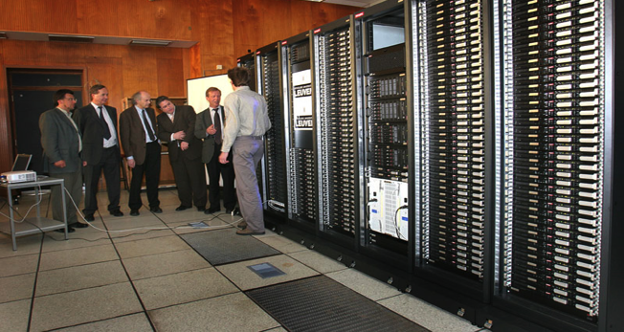
VSC – Tier 2
HPC@UGent
653 C-nodes
7896 cores
113 TFlops,
670 TB
HPC@UAntwerp
288 C-nodes
4032 cores
68 TFlops
125 TB
HPC@KULeuven+UHasselt
144 C-nodes, 3520 cores
44k GPU, 77 TFlops, 314 TB
HPC+Grid@VUB
158+104 C-nodes
2435+1800 cores
32k GPU
25+19,6 TFlops, 61+2300TB

Slide 7
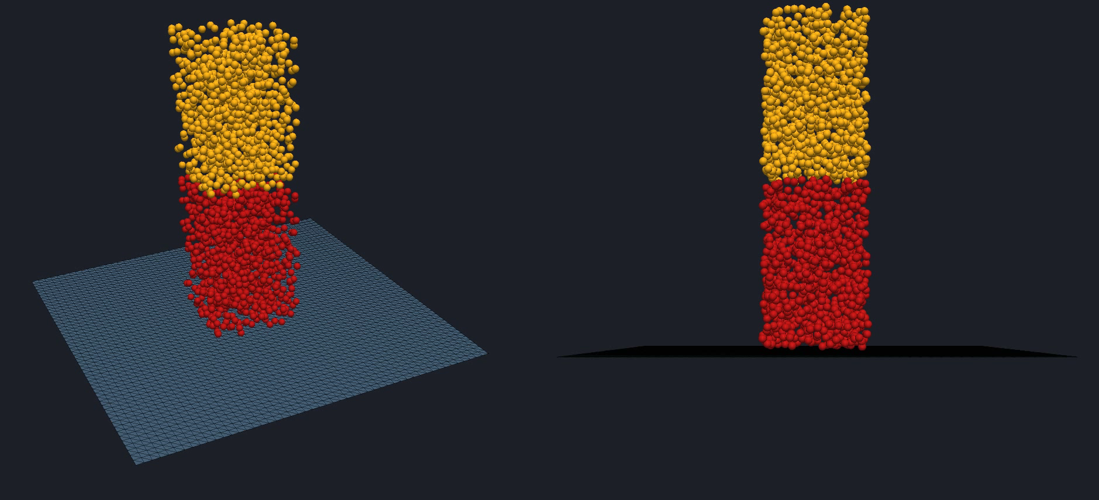
me
PhD in Science
20 years of experience in
HPC modelling/simulation, ODEs, PDEs
software development Fortran, C/C++, python
Particle based simulation DEM Research
No computer science degree
Learned most things “the hard way”

Slide 8
Message 1
if( youWantToBecomeAGoodDeveloper
&& youAreNotAComputerScientist
) {
getYourselfEducated();
}

Slide 9
Message 1
void getYourselfEducated()
{
while(!dead) {
#pragma omp sections {
#pragma omp section { IDE(); }
#pragma omp section { unitTestTools(); }
#pragma omp section { buildTools(); }
#pragma omp section { documentationTools(); }
#pragma omp section { versioningTools(); }
#pragma omp section { performanceAnalysisTools(); }
#pragma omp section { combineLanguages(); }
#pragma omp section { studyAndUseLibraries(); }
#pragma omp section { parallelizationApproaches(); }
#pragma omp section { studyHardware(); }
#pragma omp section { doYourJob(); }
#pragma omp section { updateThisList(); }
}
}
}

Slide 10
Overview
Why parallelize? Reasons 10
When parallelize? And what to do first… 16
Know your goal and minimize coding effort 34
Common approaches towards parallelization 42
What to parallelize? 45
------------------------------------------ Break ----------
Case study – Molecular Dynamics 48
Final remarks 85

Slide 11
Why parallelize?
1. Reduce time to solution
Machines have limited peak performance
2. Solve bigger problems in the same time
Machines have limited amount of memory
3. Produce more accurate solutions
typically implies
More data, e.g. more elements, basis functions, atoms, …
More computations, e.g. more detailed physics, …
Both
4. …

Slide 12
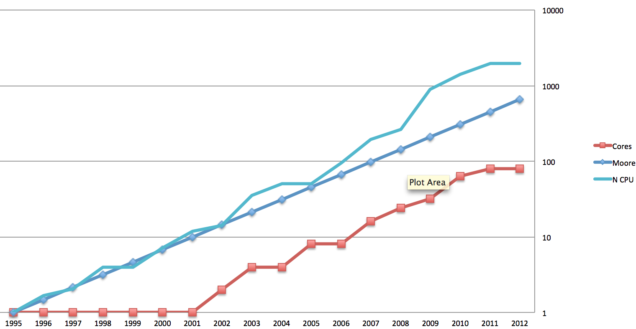
Why parallelize?
Computers get faster anyway, no?
Moore’s law still holds
# of transistors on a chip doubles every 18 months
Used to be equivalent to
program execution speed doubles every 18 months
Not any more …

Slide 13
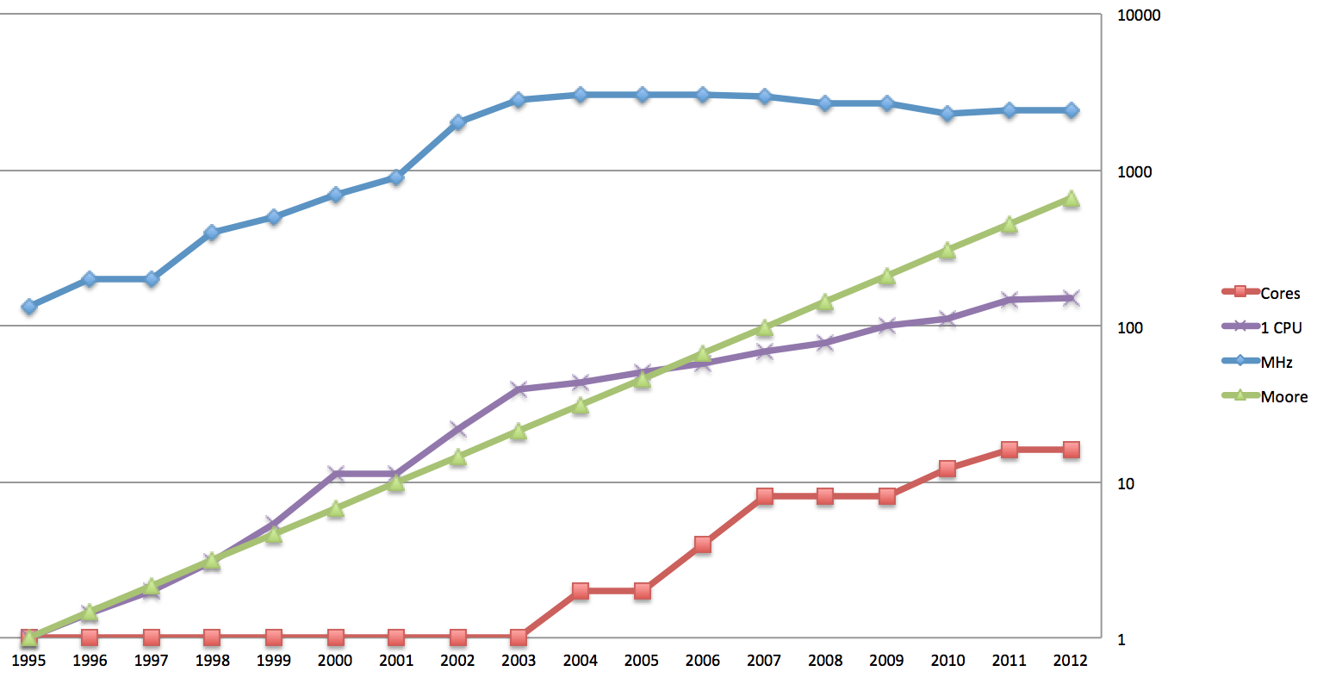
Why parallelize?
Clock frequency not going up anymore
Single core performance increases slower than moore’s law
Peak performance still increases because PP = GHz x f
f = #cores x #SMT_treads x vector_register_width = 320 (ivy bridge) = 3904 (xeon phi)

Slide 14
Why parallelize?
Single core performance increases @ 60 %/yr
DRAM memory performance increases @ 7 %/yr only
Performance gap increases @ 50 %/yr
5 years ago most applications were compute bound
Speed ~ peak performance
Today most applications are memory bound
Speed ~ peak bandwidth

Slide 15
Why parallelize?
Conclusion:
On future CPUs the speed of a serial code will certainly not increase in pace with Moore’s law
Unless you parallelize
4. Keep your code’s performance in pace with Moore’s law and stay competetive

Slide 16
Overview
Why parallelize?
When parallelize?
Know your goal and minimize coding effort
Common approaches towards parallelization
What to parallelize?
Case study

Slide 17


When parallelize?
When you hit the wall(s) …
Program takes too long
Single node memory too small
Outperformed by competitor
You need to parallelize …
Serial optimization
Fat nodes @ VSC
Are you sure? Consider

Slide 18
When parallelize? what to do first …
Optimize serial code – often significant speedup possible
Use appropriate data structure/layouts
Use appropriate algorithms
Use good tools
Intel compiler suite generally better than gcc
gcc performance varies between OS
Use HPC libraries
Prefer to extend existing codes rather reinventing the wheel
Look for well documented code
User forum traffic
Download counts
Citations
Understand and experiment with compiler options
Understand what influences the performance of your code

Slide 19
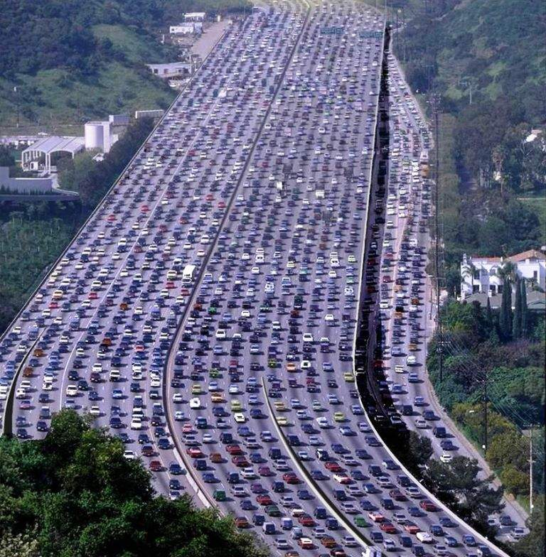
Serial optimization what influences serial performance?
Data traffic
Need ~200 cycles to move data from main memory to CPU
Core can do 4x200 single precision operations in that time

Slide 20
The cost of memory Westmere node layout
socket 1
motherboard
socket 2
CPU
CPU
P1
P2
P3
P4
P5
P6
P7
P8
P9
P10
P11
P12
32KB
32KB
32KB
32KB
32KB
32KB
2 cycles
32KB
32KB
32KB
32KB
32KB
32KB
L1
Cache hit
265KB
265KB
265KB
265KB
265KB
265KB
52 cycles
265KB
265KB
265KB
265KB
265KB
265KB
Cache
L2
L3
12MB
~400 cycles
12MB
200 cycles
Global queue
QPI
Global queue
~2000 cycles
Cache miss
DRAM
DRAM
I/O hub
Infiniband
Notes:
----- Meeting Notes (02/12/13 14:19) -----
http://sc.tamu.edu/systems/eos/Westmere-iDP.php

Slide 21
The cost of memory
UMA
Uniform memory access
Is gone
ccNUMA
Cache coherent non-uniform memory access
Multiple copies of data
Mechanisms to maintain coherency
The farther away data is from processor, the longer it takes to fetch it
Complicating factor
It is here to stay …
Overlap computation and communication = form of parallelization

Slide 22
Serial optimization what influences serial performance?
Vectorization = parallelization in a single thread
SIMD, FMA
Apply instruction to vector register instead of scalar register
Register width
128 bit = 4 SP = 2 DP Harpertown, Westmere (Turing)
256 bit = 8 SP = 4 DP Ivy Bridge (Hopper)
512 bit = 16 SP = 8 DP Xeon Phi (Vic3)
Pipelines
LI0 DI0 XI0 LI1 DI1 XI1 LI2 DI2 XI2 …
5 stage pipeline
LI0 DI0 XI0 LI5 DI5 XI5 LI10 DI10 XI10 …
LI1 DI1 XI1 LI6 DI6 XI6 LI10 DI10 …
LI2 DI2 XI2 LI7 DI7 XI7 LI10 …
LI3 DI3 XI3 LI8 DI8 XI8 …
LI4 DI4 XI4 LI9 DI9 …
Pipelines can be broken by
load/store from/to main memory
conditional branches

Slide 23

When to parallelize? and what to do first …
Criteria for efficient loops – 1
Prefer loops with high computational intensity
Number of Flops per memory access
The higher the better
SIMD very powerful, won’t help if memory bound
Code balance = (Computational intensity)⁻¹
Don’t cheat, measure useful work
a[i]+a[i]+a[i]+a[i]
Is no improvement over
4*a[i]
Loop fusion

Slide 24
Roofline model : P = min(PP,B×I)
Bandwidth limited <-|-> peak performance limited
machine peak performance
Performance [F/s]
Determine roofline of your machine (measure peak performance and bandwidth)
Measure computational intensity and performance of micro-benchmark and plot
Compare with roofline and try to understand
Bandwidth x I
Computational intensity (I) [F/B]

Slide 25
Roofline model
Bandwidth limited <-|-> peak performance limited
Performance [F/s]
Measure the computational intensity Iµ and the performance Pµ for a micro-benchmark
Iµ
-> (Iµ,Pµ)
Bandwidth limited
Close to roofline
Improve computational intensity
Pµ
Computational intensity (I) [F/B]

Slide 26
Roofline model
Bandwidth limited <-|-> peak performance limited
Performance [F/s]
Peak performance limited
below roofline
Improve memory access pattern, or do more with your data
Iµ
Pµ
Computational intensity (I) [F/B]

Slide 27
peak performance/bandwidth = FLOPs per byte you need to keep CPU busy
(for loops that read from main memory)
CPU | GHz | sockets x cores | threads per core | vector width | GHz x f (Gflops/s) | GB/s | Flops/B
Harpertown | 2.5 | 4 | 1 | 4/2 | 40 | 4 | 10
Westmere | 2.26 | 2x6 | 2 | 4/2 | 217 | 8 | 27.8
Xeon Phi | 1.24 | 61 | 4 | 16/8 | 4841 | 160 | 30
Ivy Bridge | 2.8 | 2x10 | 2 | 8/4 | 896 | 80 | 11.2

Slide 28
When to parallelize? and what to do first …
Criteria for efficient loops – 2
Prefer loops with unit stride
float a[N];
for(int i=0; i<N; i+=stride) { a[i] = … }
every load/store loads/stores an entire cache line
typically 64 Bytes = 16 SP = 8 DP
Avoid filling the cache with data you do not need
Make sure you use the data that are loaded in the cache
Prefer data structures enabling unit stride
Array of structure (AoS) vs structure of arrays (SoA)
struct Particle // AoS struct Particles // SoA
{ double x,y,z,vx,vz,vy,m; }; { double x[N],y[N],…; };
Particle particles[N]; Particles particles;
// not efficient since // efficient, also for SIMD
// non-unit stride for loops // but mind indirect data access!
// which do not use all
// properties in the struct.
// Also bad for SIMD vectorization

Slide 29

The cost of memory
Criteria for efficient loops – 3
Prefer predictable loops
Latency can be hidden by prefetching (compiler does this)
Avoid unpredictable loops
Conditional branches
Break pipelines
Indirect addressing/Pointer chasing
Bad memory access patterns, many cache misses
Compiler has no clue …

Slide 30
When to parallelize? Or what to do first …
Cache size = 32 Kb = 4K doubles
Cache line size is 64 bytes or 4 DP or 8 SP
Every read will transfer 64 bytes to L1
Main memory->L1 200 cycles
L3->L1 52 cycles
Cache misses are expensive: you easily miss hundreds of compute cycles
Exploit spatial and temporal data locality

Slide 31
When to parallelize? Or what to do first …
Spatial data locality =
make sure you use all data in a cache line
don’t jump around in main memory
> Sort data approximately in the order that you need them in loops
Temporal data locality =
once your data is in L1 cache, use it as much as possible
> Apply tiling

Slide 32
Tiling
// inefficient
// except small problems
For all items
Do this
For all items
Do that
For all items
Do something else
// data transferred 3x
// efficient
// chunk = collection of items
// that fits in L1 cache
For all chunks
For all items in chunk
Do this
For all items in chunk
Do that
For all items in chunk
Do something else
// data transferred once

Slide 33

When to parallelize? and what to do first …
Criteria for efficient loops – 4
Prefer long loops
Amortize startup and cleanup cost of pipelines and loop overhead

Slide 34
Criteria for efficient loops – summary
Prefer loops which
have high computational intensity
have unit stride
are predictable
are long

Slide 35

The numbers tell the tale
Know where to optimize
Think! – may be sufficient for small program
Otherwise, measure performance using profiling tools
gprof
Likwid-perfctr
PerfExpert
Intel Vtune
Allinea Map
Hardware counters
# instructions
# cache misses
# memory read/writes
# TLB misses
# scalar vs vector instructions

Slide 36
Overview
Why parallelize?
When to parallelize?
Know your goal and minimize coding effort
Common approaches towards parallelization
What to parallelize?
Case study

Slide 37
Know your goal Minimize coding effort
How much memory do you need?
Required time to solution?
May include development time
How many cpu years will your code run?
How much time can you afford to spend on coding?
Is anything available in open source community?
A few days of googling around may save you months of development
Your programming skills will improve more by using someone else’s good code than by trying to reinvent the wheel

Slide 38
Overview
Why parallelize?
When to parallelize?
Know your goal and minimize coding effort
Interludium
Common approaches towards parallelization
What to parallelize?
Case study

Slide 39
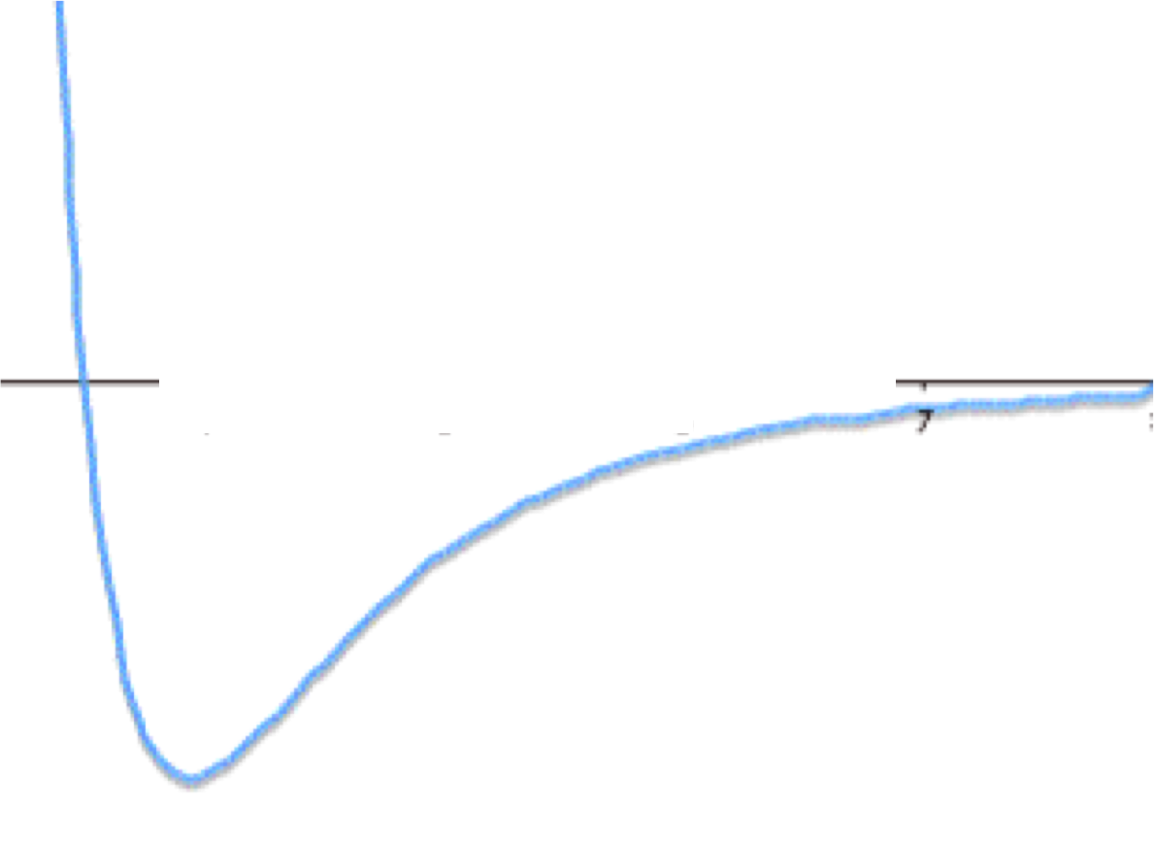
How (not) to program …
Lennard-Jones potential

Slide 40
How (not) to program …
double VLJ0( double r ) {
return 1./pow(r,12) - 1./pow(r,6);
} // 18.0 x slower
double VLJ1( double r ) {
return std::pow(r,-12) - std::pow(r,-6);
} // 14.9 x slower
double VLJ2( double r ) {
double tmp = std::pow(r,-6);
return tmp*(tmp-1.0);
} // 7.8 x slower
double VLJ3( double r ) {
double tmp = 1.0/(r*r*r*r*r*r);
return tmp*(tmp-1.0);
} // 1.01 x slower
double VLJ( Real_t r ) {
double rr = 1./r;
rr *= rr;
double rr6 = rr*rr*rr;
return rr6*(rr6-1);
} // 1 x slower

Slide 41
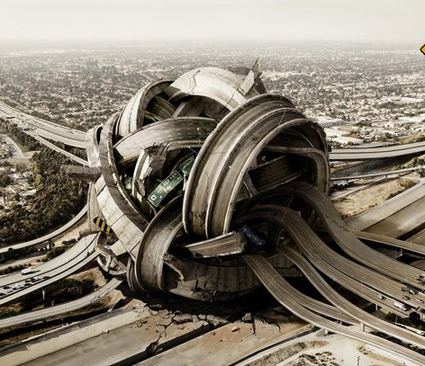
Overview
Why parallelize?
When to parallelize?
Know your goal and minimize coding effort
Common approaches towards parallelization
What to parallelize?
Case study

Slide 42
Common parallelization approaches
Shared memory machine
One global address space (not necessarily UMA!)
No (explicit) communication
Distributed memory machine
No global address space
One process per thread
Each process has its own address space
Communication between processes to share data
U
U
U
Hybrid machine
Each process manages several threads
One global address space per process
One process per socket, or per pair of SMT threads, …

Slide 43
Common parallelization approaches
Shared memory
OpenMP (C/C++/Fortran)
Intel TBB (C++)
Intel cilk++ (C++)
(Raw threads)
(MPI) (C/C++/Fortran)
Charm++ parallel objects (C++)
Global Array toolkit (C/C++)
Distributed memory
MPI
Charm++ parallel objects
Global array toolkit
Hybrid
MPI between nodes, shared memory approach in each process

Slide 44
Overview
Why parallelize? Computers get faster anyway, No?
When to parallelize? Or what to do first
Know your goal and minimize coding effort
Common approaches towards parallelization
What to parallelize?
Case study

Slide 45
What to parallelize?
Communication is overhead and slow
Bandwidth and latency order of magnitude worse than main memory access
Try overlapping communication and computation
Generally, prefer parallelizing
Large loops with high computational intensity
Tasks with little communication
Big chunks of code over small ones (coarse grained)
Chunks of a fixed load over variable loads
Otherwise, schedule largest tasks first

Slide 46

overview
Why parallelize?
When to parallelize?
Know your goal and minimize coding effort
Common approaches towards parallelization
What to parallelize?
Case study – Molecular Dynamics

Slide 47


Test case
Small molecular dynamics code
Kindly provided by Jesus Eduardo Galvan Moya from Physics Department – Condensed Matter theory
Serves many didactical (HPC) purposes
Simple code, not to big, easy to understand, …
Full of issues you should learn to pay attention to

Slide 48
Case study
Ground state energy calculation of atomistic system
0K, no velocities
10-150 atoms
Pairwise interaction potential, brute force (no cut off)
50*49/2 = 1125 pair potential evaluations
150*149/2 = 11175 pair potential evaluations
1000 runs of 200000 atom moves (Monte Carlo samples)
Followed by quasi-Newton method to improve the MC minimum
Fortran90

Slide 49
Case study
do i_run=1,1000 local minimum loop }
do i_mcs=1,200000 Monte Carlo loop } }
Etot=0 } }
do i=1,n energy loop } } }
do j=i+1,n } } }
Etot = Etot + f(r_{ij}) } } }
end do } } }
end do } } }
keep lowest energy configuration } }
end do } }
improve local minimum with quasi-newton }
end do }
keep lowest energy configuration = global minimum (hopefully)

Slide 50
Case study memory footprint
Problem size
3 position coordinates * nAtoms * 8 bytes/coordinate
50 atoms -> 1200 bytes ~ 1.2 Kb
150 atoms -> 3600 bytes ~ 3.6 Kb
L1 Cache size = 32 Kb per core
Fits in L1 cache easily, no need for tiling

Slide 51
Case study - optimization
Which parts in the code need optimization?
Energy loop (pairs of atoms)
Small part of code
Executed most often 1125x200000x1000
Definitely needs optimization (“What to do first”)
Monte Carlo loop
NR part represents small fraction of loop, little to be gained
Global minimum loop
Mainly just a loop

Slide 52
Case study – optimization Energy loop
do i=1,N
ri(1) = x(i)
ri(2) = y(i)
ri(3) = z(i)
do j=i+1,N
rj(1) = x(j)
rj(2) = y(j)
rj(3) = z(j)
Etotal = Etotal + Energy2(ri,rj)
end do
end do

Slide 53
Case study – optimization Energy loop
function Energy2(ra,rb)
!...
r=sqrt((rb(1)-ra(1))**2+(rb(2)-ra(2))**2+(rb(3)-ra(3))**2)
Energy = Energy1(r)
return
end
function Energy1(r)
!...
intpot_fitting = Acoeff*exp(-alpha*r)/r**npow - Bcoeff*exp(-beta*(r-catt))/((r-catt)**nattractive+datt) - 0*Ccoeff/r
return
end

Slide 54
Case study – optimization Energy loop
function Energy2(ra,rb)
!...
r=sqrt((rb(1)-ra(1))**2+(rb(2)-ra(2))**2+(rb(3)-ra(3))**2)
Energy = Energy1(r)
return
end
function Energy1(r)
!...
intpot_fitting = Acoeff*exp(-alpha*r)/r**npow - Bcoeff*exp(-beta*(r-catt))/((r-catt)**nattractive+datt) - 0*Ccoeff/r
Return
end
+,-,* are cheap 1 cycle
/, exp(.), sqrt(.) are expensive ~20 cycles
pow(.,.) is very expensive ~100 cycles
Both functions have high computational intensity
Loops will be compute bound

Slide 55
Case study – optimization Energy loop
50 atoms
Fortran version 150 µs (auto-vectorization turned off)
C/C++ version 144 µs
I am not a Fortran specialist
Tried to optimize a C/C++ version first

Slide 56
Case study – optimization Energy loop
Energy loop contains two nested function calls
Prevents C++ from vectorizing the inner loop
Remove call to Energy, compute interatomic distance rij in loop body and call intpot_fitting
144->96 µs (now vectorized)

Slide 57
Case study – optimization Energy loop
Intpot_fitting contains division by power:
Acoeff*exp(-alpha*r)/r**npow
Equivalent to
Acoeff*exp(-alpha*r)*r**(-npow)
But saves a division ~20 cycles
144->96->93 µs
Only small gain because Intpot_fitting is expensive anyway (5 intrinsic function calls)

Slide 58
Case study – optimization Energy loop
Remove the call to intpot_fitting and compute in the body of the loop
144->96->93->93 µs
Compiler good at inlining 1 function call, not 2.

Slide 59
Case study Energy loop
Inner loop runs over [i+1,N[
So its data is not always well aligned
Can slow down vectorization
Let inner loop run over [0,i[
144->96->93->93->93 µs

Slide 60
Case study – optimization Energy loop
N-1 inner loops, not very long
Split loop
Compute and store interatomic distance in array of length N*(N-1)/2 = 1225
loop over atomic distance array and compute intpot_fitting in one long array instead of many short ones
144->96->93->93->93->86µs
Criteria for efficient loops – 4 – Prefer long loops

Slide 61
Case study – optimization Energy loop
for( int i=1, ij=0; i<N; ++i ) {// may safely skip i=1
Real ri[3] = { x[i],y[i],z[i] };
for( int j=0; j<i; ++j, ++ij ) {
r[ij] = sqrt( sq(x[j]-ri[0])
+ sq(y[j]-ri[1])
+ sq(z[j]-ri[2]) );
}
}
Etotal = 0;
for( int ij=0; ij<N*(N-1)/2; ++ij ) {
Etotal += Acoeff*exp(-alpha*r[ij])/pow(r[ij],npow)
- Bcoeff*exp(-beta*(r[ij]-catt))/ (pow(r[ij]-catt,nattractive)+datt)
- 0*Ccoeff/r[ij];
}
Keep sqrt for computational intensity

Slide 62
Case study Energy loop
Applying the same techniques in fortran
Auto-vectorization
150->95 µs
Lower triangle and remove a division
150->95->88 µs
Loop splitting
150->95->88->85 µs

Slide 63
Case study – optimization Energy loop
Same result as C++ -> confidence
Analysis
Programming language used
Common misconception
Fortran is efficient
C++ is not efficient
Rather :
Computational efficiency necessitates a particular programming style (stay away from high level C++ features)

Slide 64
Are we satisfied …
Speedup 95->85 µs = 1.12 ☹
150 atoms (x3) -> 747µs (x8.7 ~ x3²)
Energy loop is O(N²)
Atoms x10 -> cputime x100 ☹
Alternatives?

Slide 65
Case study – optimization Energy loop
Understand your code!
This Monte Carlo sampling moves only one atom at a time
For N atoms only N-1 interatomic distances and interaction energies change instead of all N(N-1)/2
N(N-1)/2 ~ N²/2
Exploit this!

Slide 66
Store r_{ij}
r_{ij} | 0 | 1 | 2 | 3 | 4 | 5 | 6
0
1 | 0
2 | 1 | 2
3 | 3 | 4 | 5
4 | 6 | 7 | 8 | 9
5 | 10 | 11 | 12 | 13 | 14
6 | 15 | 16 | 17 | 18 | 19 | 20
Linear array containing r10, r20, r21, r30, r31, r32, r40, r41, r42, r43, …

Slide 67
Store E_{ij} and row sums
E_{ij} | 0 | 1 | 2 | 3 | 4 | 5 | 6 | E_{row}
0
1 | 0 |  |  |  |  |  |  | E₀
2 | 1 | 2 |  |  |  |  |  | E₁+E₂
3 | 3 | 4 | 5 |  |  |  |  | E₃+E₄+E₅
4 | 6 | 7 | 8 | 9 |  |  |  | E₆+…+E₉
5 | 10 | 11 | 12 | 13 | 14 |  |  | E₁₀+…+E₁₄
6 | 15 | 16 | 17 | 18 | 19 | 20 |  | E₁₅+…+E₂₀

Slide 68
Move 1 atom
E_{ij} | 0 | 1 | 2 | 3 | 4 | 5 | 6 | E_{row}
0
1 | 0 |  |  |  |  |  |  | E₀
2 | 1 | 2 |  |  |  |  |  | E₁+E₂
3 | 3 | 4 | 5 |  |  |  |  | E₃+E₄+E₅
4 | 6 | 7 | 8 | 9 |  |  |  | E₆+…+E₉
5 | 10 | 11 | 12 | 13 | 14 |  |  | E₁₀+…+E₁₄
6 | 15 | 16 | 17 | 18 | 19 | 20 |  | E₁₅+…+E₂₀
Atom 4 is moved, row 4 and column 4 change

Slide 69
New algorithm
i\j | 0 | 1 | 2 | 3 | 4 | 5 | 6 | E_{row}
0
1 | 0 |  |  |  |  |  |  | E₀
2 | 1 | 2 |  |  |  |  |  | E₁+E₂
3 | 3 | 4 | 5 |  |  |  |  | E₃+E₄+E₅
4 | 6 | 7 | 8 | 9 |  |  |  | E₆+…+E₉
5 | 10 | 11 | 12 | 13 | 14 |  |  | E₁₀+…+E₁₄-E₁₄+E’₁₄
6 | 15 | 16 | 17 | 18 | 19 | 20 |  | E₁₅+…+E₂₀-E₁₉+E’₁₉
More code, loops harder to optimize for compiler (shorter loops, varying stride, …)
E.g. recompute loops not vectorized yet …
Little hope for auto-vectorization
SIMD Vectorization certainly possible using Vectorization library (e.g. Vc or Boost.simd in NT²). Expect speedup x2 on Turing, x4 on Hopper
Nontrivial code requires documentation

Slide 70
What did we gain?
nAtoms
50
150 (x3)
500 (x10)
O(N²)
86
(x9)
8616 (x100)
O(N)
5.7
17.3 (x3)
57 (x10)
Speedup
15.1
43.2
151.2
Always look for O(N) algorithms if problem size is likely to grow in the future
Always start with the simplest algorithm so you have a reference for correctness testing

Slide 71
Profiling with PerfExpert
PerfExpert is a tool that combines a simple user interface with a sophisticated analysis engine to:
Detect and diagnose the causes for core, socket, and node-level performance issues.
Provide a performance analysis report and suggestions for remediation.
Apply pattern-based software transformations to enhance performance.

Slide 72
Profiling with PerfExpert
PerfExpert output of inner loop above:
Loop in function __svml_pow2_h9 in ~unknown-file~:0 (68.58% of the total runtime)
===============================================================================
ratio to total instrns % 0..........25..........50..........75..........100
- floating point 100.0 **************************************************
- data accesses 25.4 *************
* GFLOPS (% max) 27.3 **************
- packed 15.2 ********
- scalar 12.1 ******
-------------------------------------------------------------------------------
performance assessment LCPI good.......okay........fair........poor........bad
* overall 0.58 >>>>>>>>>>>>
* data accesses 0.91 >>>>>>>>>>>>>>>>>>
- L1d hits 0.89 >>>>>>>>>>>>>>>>>>
- L2d hits 0.02
- L3d hits 0.00
- LLC misses 0.00
…
The program spends 69% evaluating std::pow(.,.)
(Also 18% on std::exp(.))
These are called by f(rij).
The program is compute bound (as expected).
The overall performance is considered okay
Roughly half of the instructions is still scalar, although pow and exp are vectorized (svml prefix).
Still room for improvement?
Interaction potential very expensive
2 pow, 2 exp, 1 sqrt, 3 div
Still high fraction of scalar code
Data fits in L1d cache (as expected).

Slide 73
Case study - Parallelization
Which part in the code can be parallelized?
Energy loop (pairs of atoms)
Small part of code
Executed most often 1125x1000x200000
MC sampling loop
Local minimum loop
Each can be parallelized
Which is best?

Slide 74
Case study
Approach -> OpenMP
Simple from programmer’s point of view
When using OpenMP always go for intel compiler suite overhead start/stop/synchronization is much larger for gcc OpenMP than for intel OpenMP
Intel ~ 100s of cycles
Gcc ~ 1000s of cycles
There are very good alternatives to OpenMP
Intel Threading Building Blocks (TBB)
Intel Cilk++
(but not for Fortran)
Disadvantage = shared memory

Slide 75
Case study // energy loop
Energy loop relatively short (trip count 1225) and fine grained
Overhead of starting and stopping OpenMP threads will kill us
O(N) algorithm even worse

Slide 76
Case study // MC loop
MC sampling loop much longer (trip count 200.000) and coarse-grained
Using OpenMP we should be able to run 24 threads
good code balance -> threads can be kept busy
small memory footprint -> everything can stay in cache
Ideal situation
Each thread would do 200.000/24 atom moves (and Etot computations)
Sufficient to amortize overhead of starting and stopping OpenMP threads
This leaves quasi-Newton minimization serial

Slide 77
Case study // global minimum loop
Global minimum loop small trip count (1000) but very coarse grained
Could be parallelized with OpenMP
Limited to single node = 24 OpenMP threads
time to solution is 1000/24=42 x serial execution time

Slide 78
Case study
!$ omp parallel for
do i_run=1,1000
do i_mcs=1,200000
Etot=0
do i=1,n
do j=i+1,n
Etot = Etot + f(r_{ij})
end do
end do
keep lowest energy configuration
end do
improve local minimum with NR
end do
keep lowest energy configuration
!$ omp parallel endfor
OpenMP threads
Westmere 24
Ivy Bridge 40

Slide 79
Case study // global minimum loop
Think!
Global minimum loop iterations are completely independent – no communication between iterations
Apply process parallelism

Slide 80
Case study process parallelism
Strip outer loop from program
new program computes single local minimum
Run this program 1000 times
Worker framework – can be done with one job
Westmere node can run 24 instances of program simultaneously
Use a script (python, bash) to process the output of the jobs to pick the global minimum

Slide 81
Case study
do i_run=1,1000 // worker framework
do i_mcs=1,200000
Etot=0
do i=1,n
do j=i+1,n
Etot = Etot + f(r_{ij})
end do
end do
keep lowest energy configuration
end do
improve local minimum with NR
end do
keep lowest energy configuration // post-processing script
Now a program
MPI threads
Westmere 24 x #nodes
Ivy Bridge 40 x #nodes

Slide 82
Case study SMT
Westmere nodes can run 2 threads per core (SMT)
SMT = simultaneous multithreading
While thread 1 is not using some functional unit, that functional unit can be used by thread 2
Thread 2 “feeds on leftovers of thread 1”
Overlap memory traffic and instruction execution
Thread scheduling done by hardware
Speedup at most 2, usually less

Slide 83
Case study SMT
Westmere nodes can run 2 threads per core (SMT)
Use worker framework
12 threads (no SMT) 68.5 cpu seconds/thread
24 threads (SMT) 96.8 cpu seconds/thread
Slowdown of 1.4 for 2x instances
Throughput x 1.42
Time to solution for 1000 runs
Using 1000/24 = 42 nodes ~ 1.42 x t_serial_execution
Using 1000/12 = 84 nodes ~ 1.00 x t_serial_execution

Slide 84
Case study process parallelism
Program parallelization only necessary if the time to solution must be less than t_serial_execution
This comes at a cost
More cputime because of communication
Development time

Slide 85
Overview
Why parallelize?
When parallelize?
Know your goal and minimize coding effort
Common approaches towards parallelization
What to parallelize?
Case study – Molecular Dynamics
Final remarks

Slide 86

Final remarks
Reasons to parallelize
But, before you parallelize,
But, before you optimize,
Before you write code,
In any case,
engelbert.tijskens@uantwerpen.be
Optimize!
Profile your code
Consider reusing OS code
Talk to us

Slide 87

Test
If you would have to reduce time to solution, which loop would you parallelize?
Energy loop
MC sampling loop
Local minimum loop Loop
Which approach would you use, ant why
OpenMP
MPI

